Slide 1
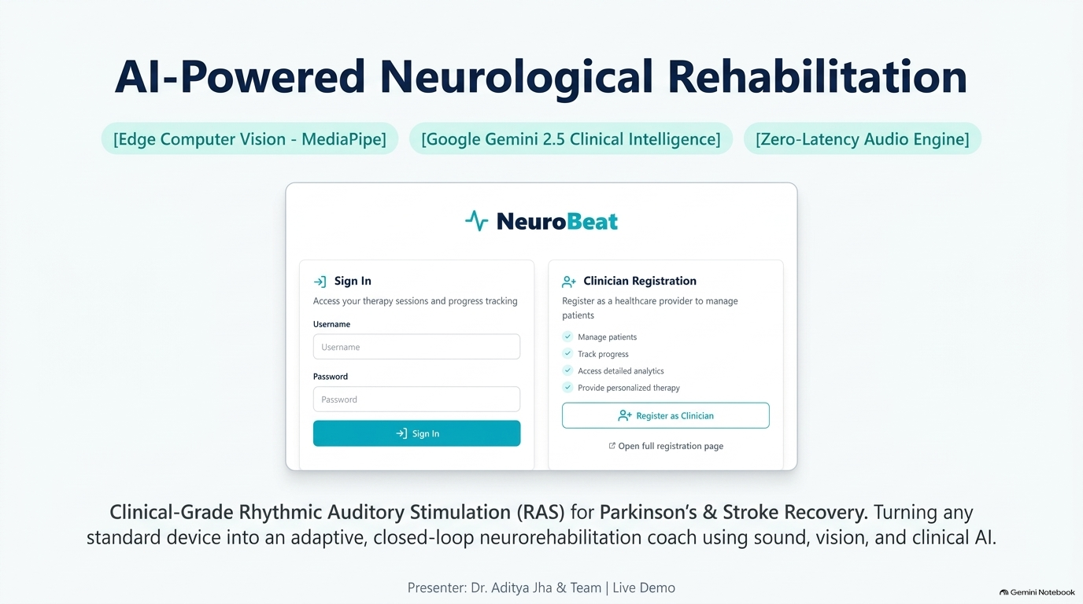

Slide 2
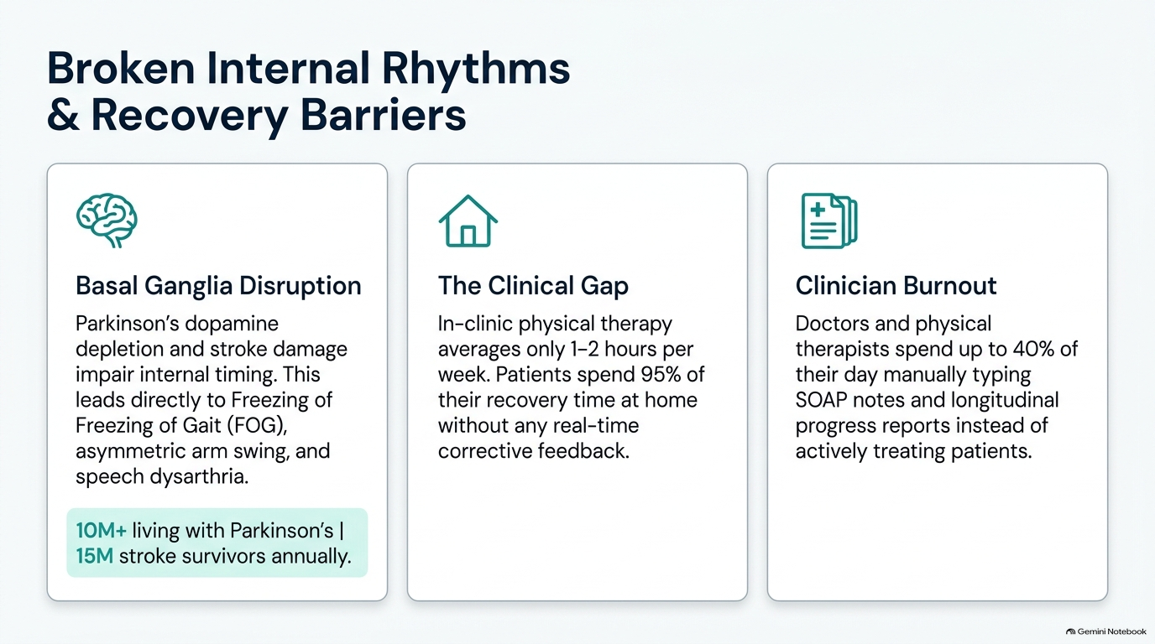

Slide 3
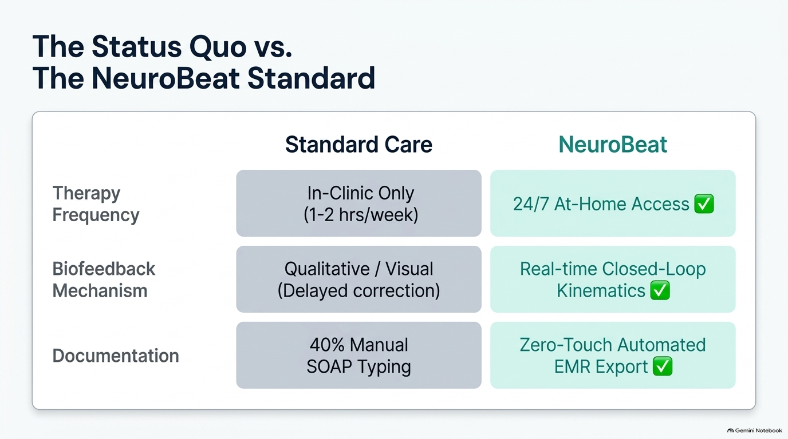

Slide 4
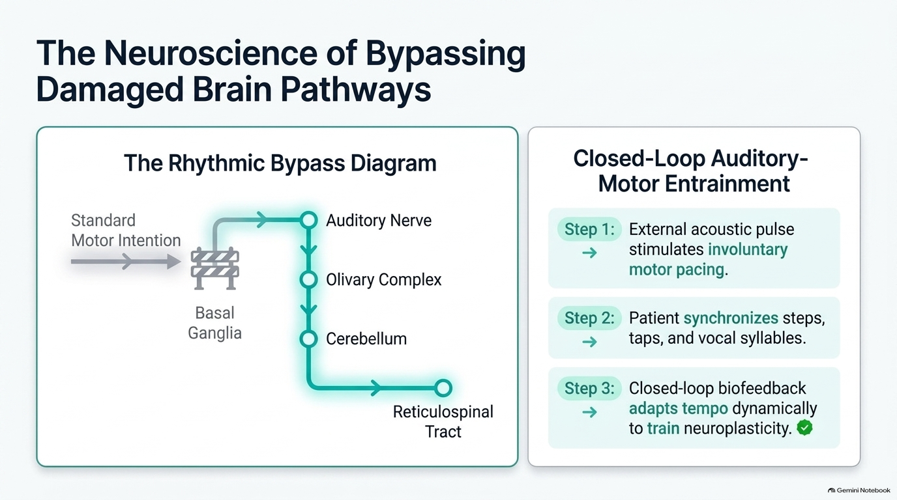

Slide 5
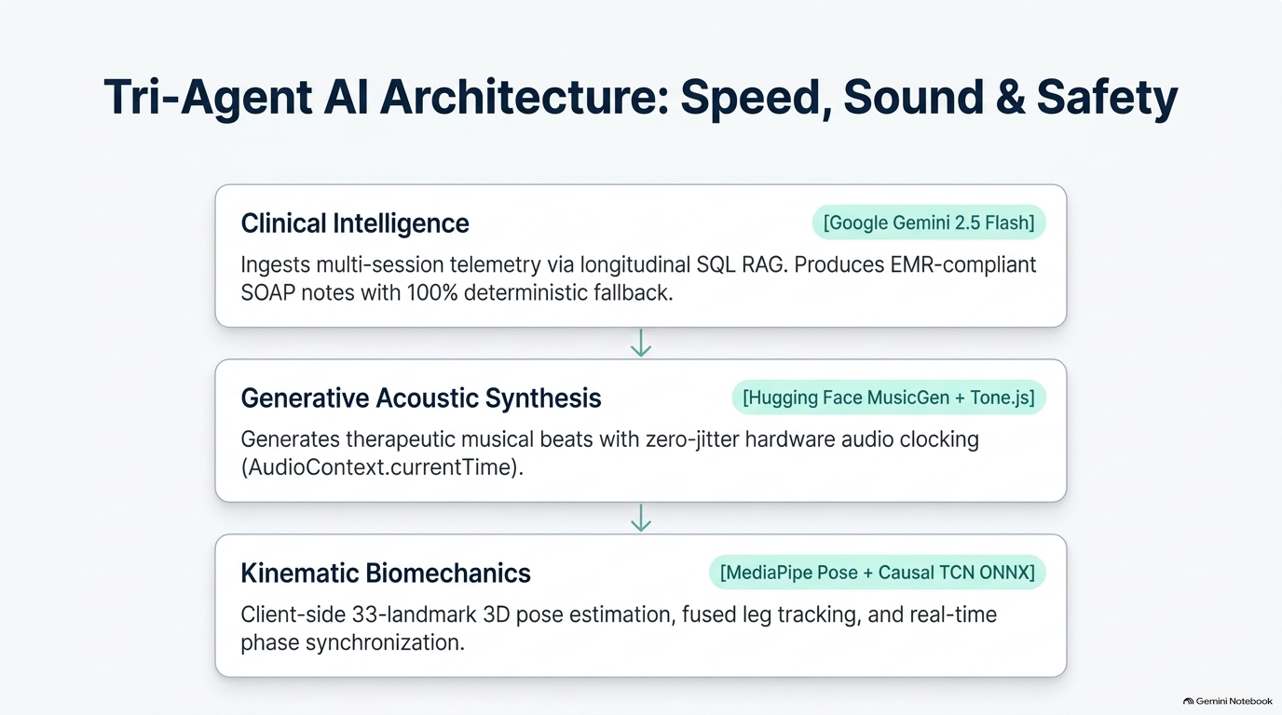

Slide 6
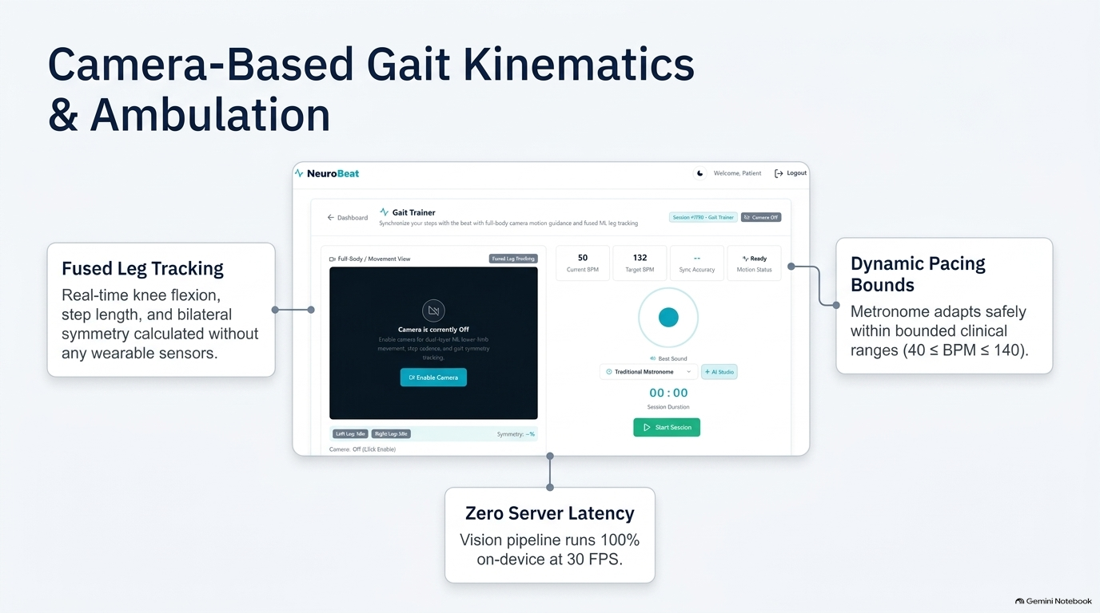

Slide 7
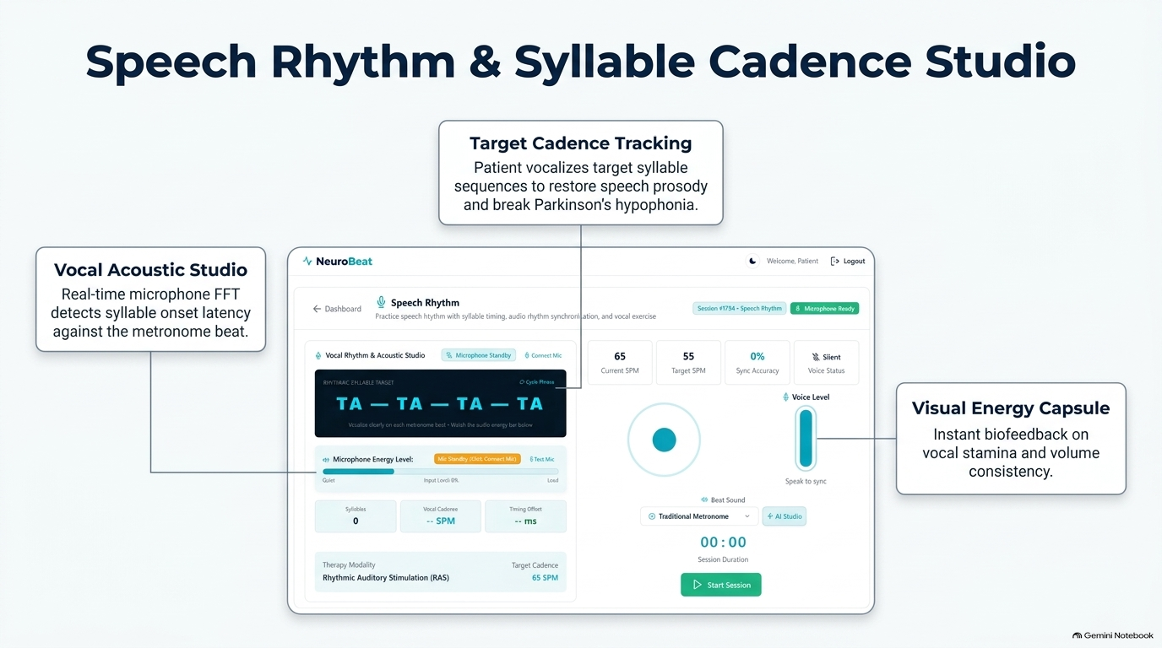

Slide 8
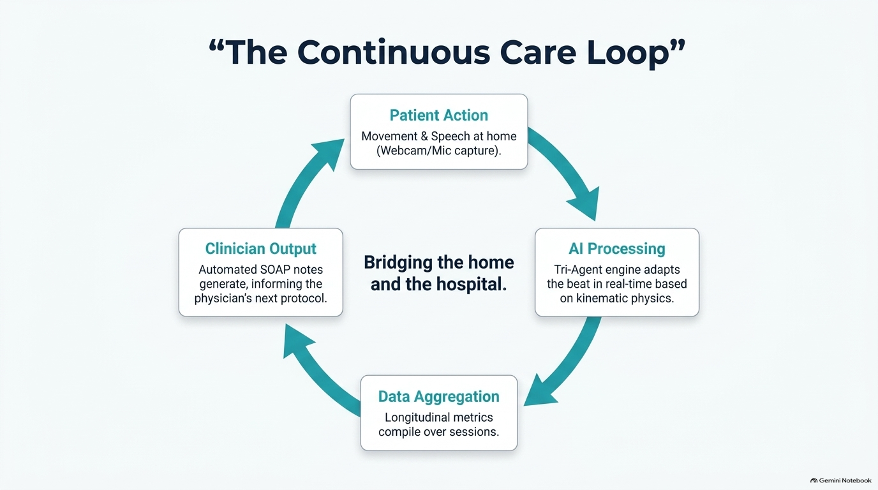

Slide 9

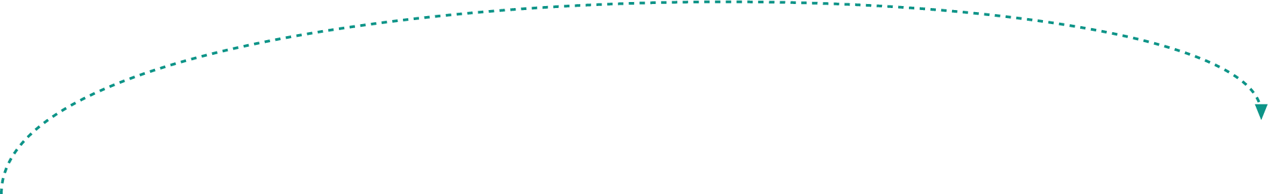











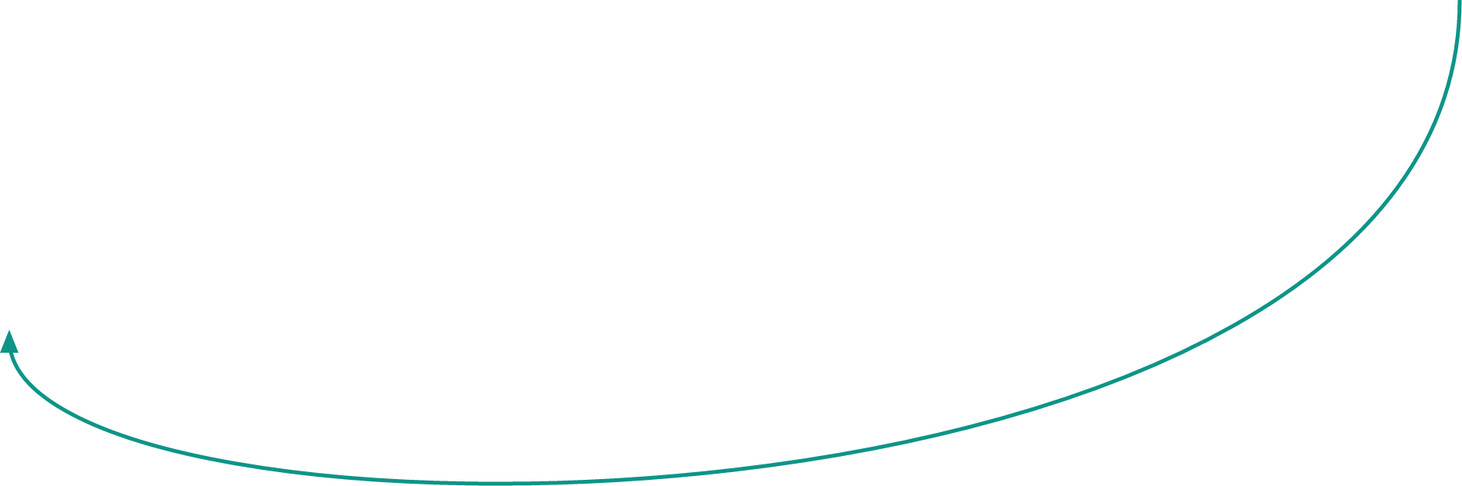





NeuroBeat: Closed-Loop AI Architecture
1. Edge Perception
2. Measurement & Metrics
3. P3 Agentic Core
4. Cyber-Actuation
5. Cloud Clinical Layer
👤 Patient Input
Movement & Voice Capture via Webcam/Mic
📊 Clinical Metrics Engine
Computes real-time Cadence, Bilateral Symmetry & RMSE Sync
💾 SQLite Database
Stores raw telemetry & session metrics
🧠 Adaptive Engine
Evaluates patient entrainment. Proposes dynamic pacing modifications (e.g. INCREASE_TEMPO +3 BPM).
🤖 MediaPipe Landmarker
Runs locally on WebAssembly for 33 3D skeletal points
🎵 Audio Synthesizer
Real-time acoustic cue adjustment. Modifies metronome beat timing instantly to guide patient gait.
✨ Gemini 2.5 Flash
Few-Shot LLM engine for clinical synthesis
📈 Performance Score
Maintains 12-second rolling buffer to evaluate stability
⚙️ NuroMotion Feature
Extracts joint velocity & detects discrete STEP events
📝 Clinical SOAP Notes
Automates EMR integration & patient coaching feedback
👁️ State Observer
Determines trajectory (Improving, Stable, or Declining)
⏱️ Phase Alignment
Calculates millisecond error vs. audio beat
🛡️ NuroActionValidator
Deterministic Safety Bounds
• Max BPM limit (40-140)
• Visual confidence > 45%
• Prevents sudden velocity spikes
End-to-End Operational Lifecycle
1. Local Edge Processing
MediaPipe & NuroMotion extract gait kinematics natively in-browser at 30+ FPS, ensuring 0ms server latency & complete privacy.
2. Agentic Closed-Loop Control
The Adaptive Engine analyzes performance trends, proposing live tempo shifts validated deterministically before driving acoustic metronome feedback.
3. Automated EMR Post-Processing
Session telemetry streams directly to Gemini 2.5 Flash, structuring instant SOAP notes that eliminate 100% of documentation overhead.

Slide 10
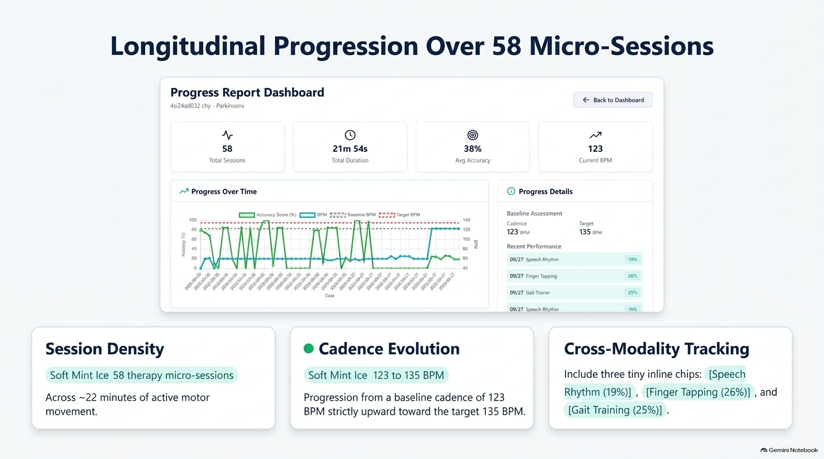

Slide 11
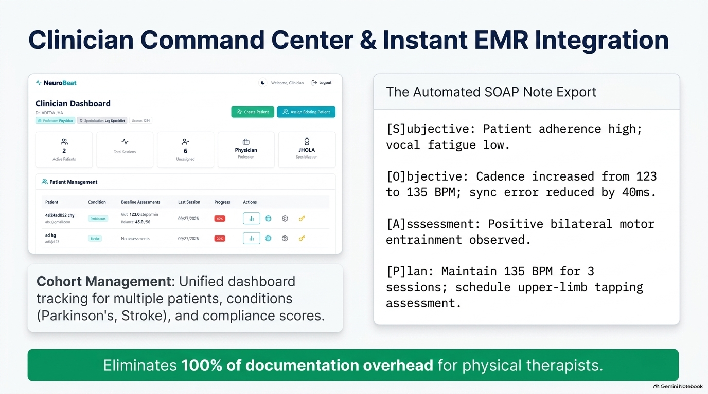

Slide 12
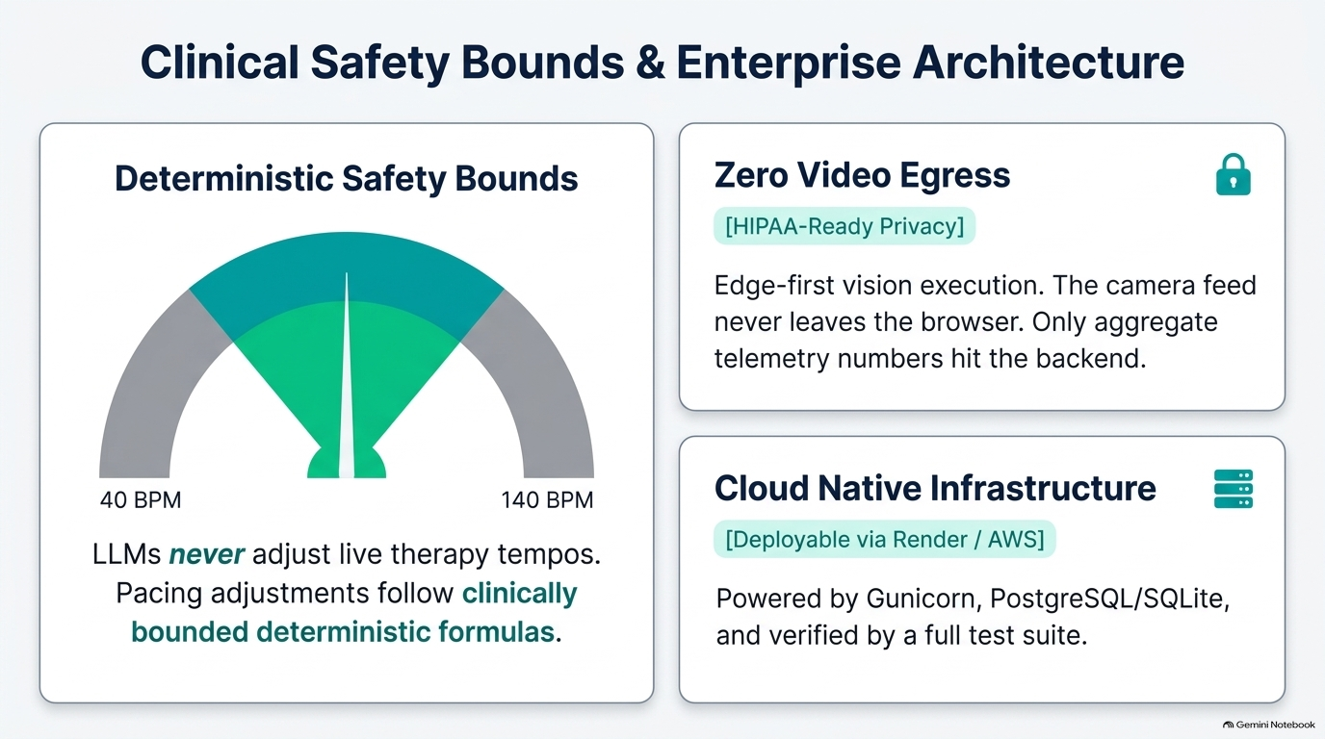

Slide 13
